Slide 1
Course Introduction & Data Analysis Overview

Slide 2
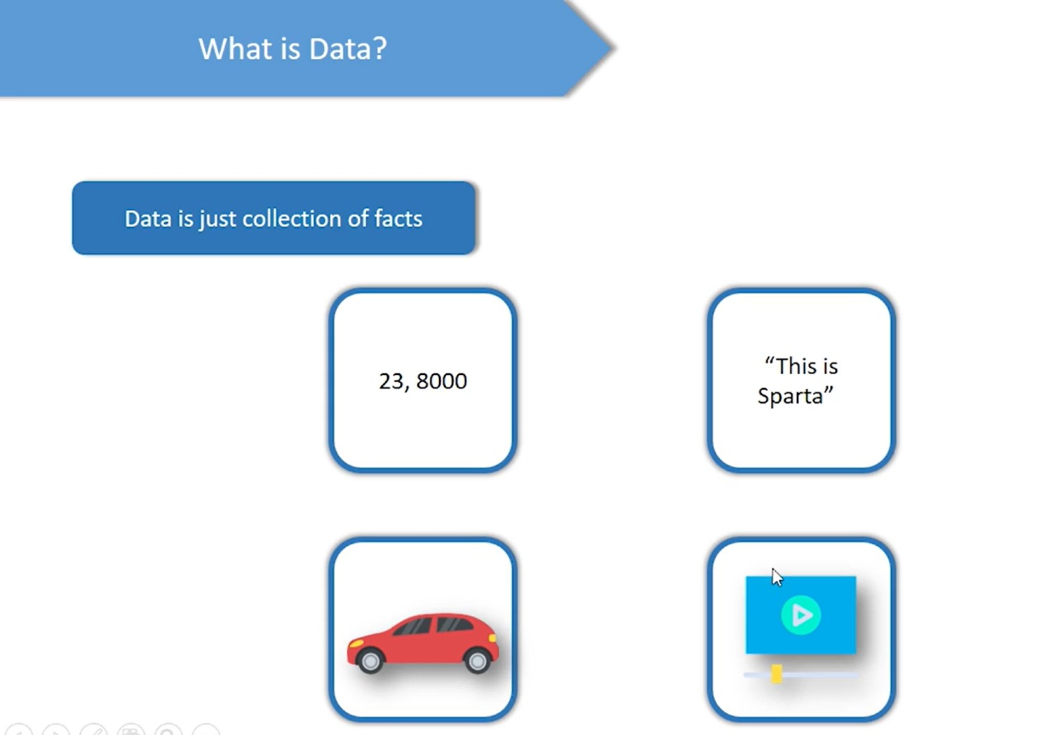
Defining Data

Slide 3
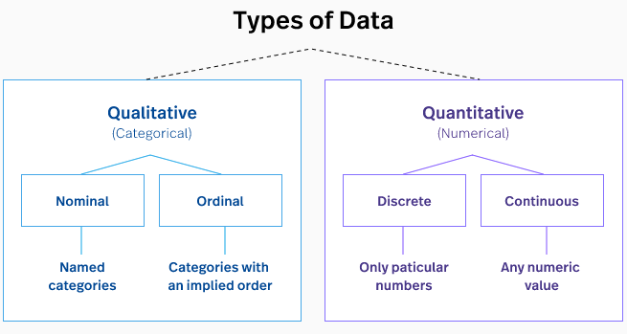
Defining Data
Data is a plural for “Datum”, which is a Latin word.
Data are individual facts, statistics, or items of information,
often numeric.
In a more technical sense-
Data are a set of values of qualitative or quantitative variables about one or more persons or objects, while a datum is a single value.

Slide 4
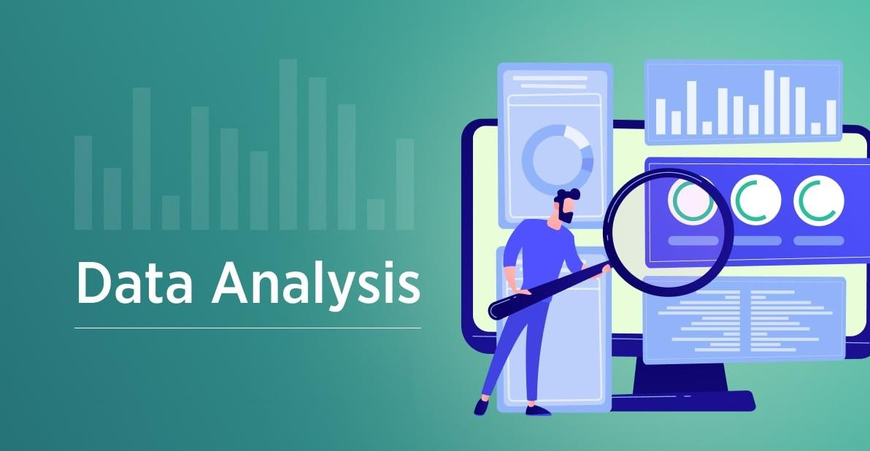
What is Data Analysis?
What is Data Analysis?
Data analysis is defined as a process of cleaning, transforming, and modeling data to discover useful information for business decision-making. The purpose of Data Analysis is to extract useful information from data and taking the decision based upon the data analysis.
A simple example of Data analysis is whenever we take any decision in our day-to-day life is by thinking about what happened last time or what will happen by choosing that particular decision. This is nothing but analyzing our past or future and making decisions based on it. For that, we gather memories of our past or dreams of our future. So that is nothing but data analysis. Now same thing analyst does for business purposes, is called Data Analysis.
Source: velvetech.com

Slide 5
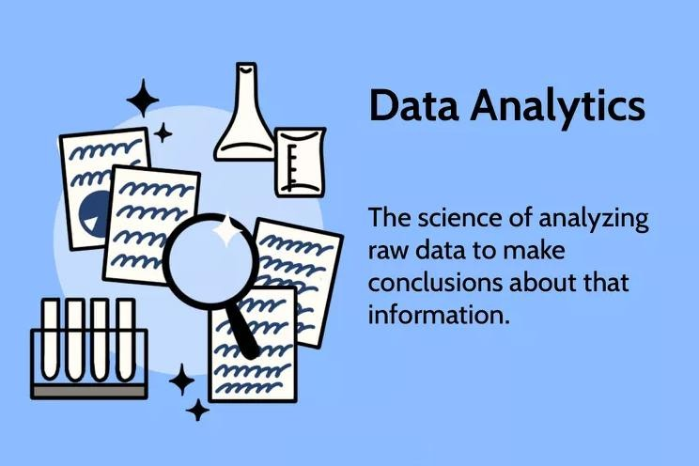
What Is Data Analytics?
What Is Data Analytics?
Data analytics is the science of analyzing raw data to make conclusions about that information. Many of the techniques and processes of data analytics have been automated into mechanical processes and algorithms that work over raw data for human consumption.
Source: investopedia.com

Slide 6
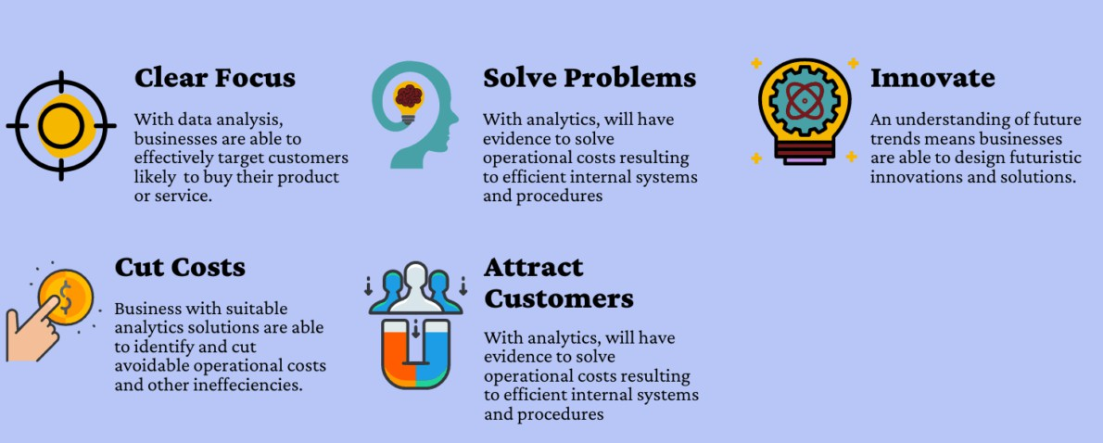
Why Data Analysis?
Why Data Analysis?
To grow your business even to grow in your life, sometimes all you need to do is Analysis!
If your business is not growing, then you have to look back and acknowledge your mistakes and make a plan again without repeating those mistakes. And even if your business is growing, then you have to look forward to making the business to grow more. All you need to do is analyze your business data and business processes.
Source: sdsclub.com

Slide 7
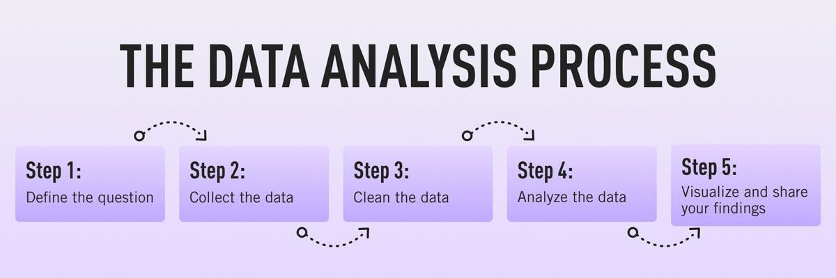
What Is The Data Analysis Process?
What Is The Data Analysis Process?
When we talk about analyzing data there is an order to follow in order to extract the needed conclusions. The analysis process consists of 5 key stages.
Source: careerfoundry.com

Slide 8


What Is The Data Analysis Process?
Identify:
Before you get your hands dirty with data, you first need to identify why do you need it in the first place. The identification is the stage in which you establish the questions you will need to answer. For example, what is the customer's perception of our brand? Or what type of packaging is more engaging to our potential customers? Once the questions are outlined you are ready for the next step.
Collect:
As its name suggests, this is the stage where you start collecting the needed data. Here, you define which sources of information you will use and how you will use them. The collection of data can come in different forms such as internal or external sources, surveys, interviews,
questionnaires,
focus
here is that the way be different in a
groups, among others.
An you collect the quantitative and
important note information will
qualitative scenario.

Slide 9


What Is The Data Analysis Process?
Clean:
Once you have the necessary data it is time to clean it and leave it ready for analysis. Not all the data you collect will be useful, when collecting big amounts of information in different formats it is very likely that you will find yourself with duplicate or badly formatted data. To avoid this, before you start working with your data you need to make sure to erase any white spaces, duplicate records, or formatting errors. This way you avoid hurting your analysis with incorrect data.
Analyze:
With the help of various techniques
such as statistical analysis,
regressions, neural networks, text analysis, and more, you can start analyzing and manipulating your data to extract relevant conclusions. At this stage, you find trends, correlations, variations, and patterns that can help you answer the questions you first thought of in the identify stage. Various technologies in the market assists researchers and average business users with the management of their data. Some of them include business intelligence and visualization software, predictive analytics, data mining, among others.

Slide 10

What Is The Data Analysis Process?
Sharing your results:
You’ve finished carrying out your analyses. You have your insights. The final step of the data analytics process is to share these insights with the wider world (or at least with your organization’s stakeholders!) This is more complex than simply sharing the raw results of your work—it involves interpreting the outcomes, and presenting them in a manner
that’s digestible for all types of audiences. Since you’ll often present information to decision-makers, it’s very important that the insights you present are 100% clear and unambiguous. For this reason, data analysts commonly use reports, dashboards, and interactive visualizations to
support their findings.

Slide 11
Types of data analysis
Descriptive analysis:
Descriptive analysis tells us what happened. This type of analysis helps describe or summarize quantitative data by presenting statistics. For example, descriptive statistical analysis could show the distribution of sales across a group of employees and the average sales figure per employee.
Descriptive analysis answers the question, “what happened?”
Example:
Traffic and Engagement Reports
Financial Statement Analysis
Demand Trends
Aggregated Survey Results
Progress to Goals

Slide 12
Types of data analysis
Diagnostic analysis:
If the descriptive analysis determines the “what,” diagnostic analysis determines the “why.” Let’s say a descriptive analysis shows an unusual influx of patients in a hospital. Drilling into the data further might reveal that many of these patients shared symptoms of a particular virus. This diagnostic analysis can help you determine that an infectious agent—the “why”—led to the influx of patients.
Diagnostic analysis answers the question, “why did it happen?”
Example:
Examining Market Demand
Explaining Customer Behavior
Identifying Technology Issues
Improving Company Culture

Slide 13
Types of data analysis
Predictive analysis:
So far, we’ve looked at types of analysis that examine and draw conclusions about the past. Predictive analytics uses data to form projections about the future. Using predictive analysis, you might notice that a given product has had its best sales during the months of September and October each year, leading you to predict a similar high point during the upcoming year.
Predictive analysis answers the question, “what might happen in the future?”
Example:
Finance: Forecasting Future Cash Flow
Health Care: Early Detection of Allergic Reactions
Sales: Sales Forecasting

Slide 14
Types of data analysis
Prescriptive analysis:
Prescriptive analysis takes all the insights gathered from the first three types of analysis and uses them to form recommendations for how a company should act. Using our previous example, this type of analysis might suggest a market plan to build on the success of the high sales months and harness new growth opportunities in the slower months.
Prescriptive analysis answers the question, “what should we do about it?”
Banking: Fraud Detection
Product Management: Development and Improvement

Slide 15
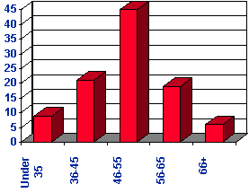
Mathematical and Statistical Methods for Data Analysis
Descriptive Analysis:
The Distribution
The distribution is a summary of the frequency of individual values or ranges of values for a variable.
Central Tendency
The central tendency of a distribution is an estimate of the “center” of a distribution of values. There are three major types of
estimates of central tendency:
Mean
Median
Mode

Slide 16
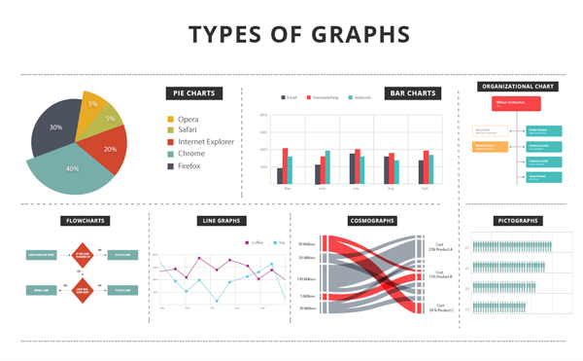
Mathematical and Statistical Methods for Data Analysis
Descriptive Analysis:
Graphs and Visualization
We are visually oriented creatures. Images and displays attract our attention and stay in our memory longer. The techniques include:
Area Chart
Bubble Chart
Column Charts and Bar Charts
Funnel Chart
Gantt Chart
Line Chart
Pie Chart
Radar Chart
Word Cloud Chart

Slide 17
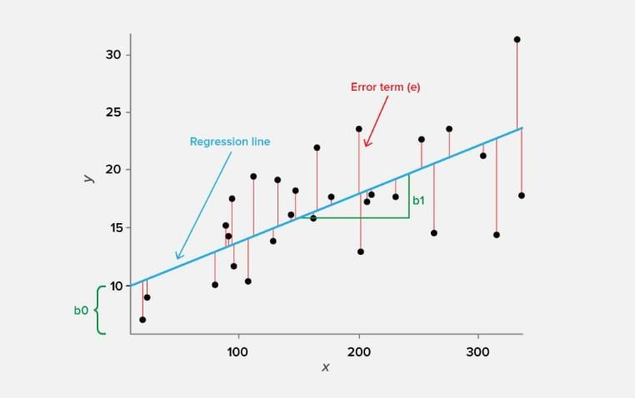
Mathematical and Statistical Methods for Data Analysis
Regression Analysis:
General Overview
This method of analysis is used to understand the relationship between dependent variables and independent variables. A dependent (or “main”) variable is the thing you want to understand (e.g., in-store sales figures). Independent variables are the factors that might be impacting your dependent variable (e.g., the weather).
How Does It Work?
By plotting the different set points of the variables to a graph, you will be able to determine, with a higher degree of certainty, what the relationship is between your variables.
Example
Say you plotted the daily sales figures of your business on the y- axis of your graph. On the x-axis, you plotted the amount of rain that fell on the corresponding days. Looking at the data points, you could, with some certainty, predict how the rain (your independent variable) impacts sales (your dependent variable).
Source: serokell

Slide 18
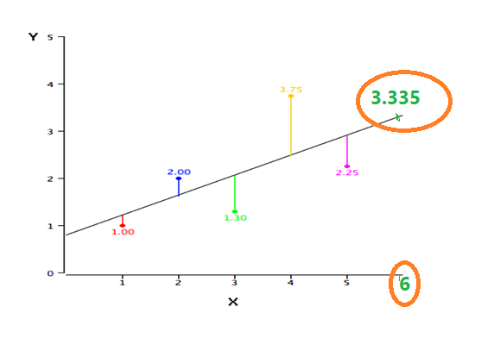
Mathematical and Statistical Methods for Data Analysis
Regression Analysis:
X (Independent Variable) | Y (Dependent Variable)
1.00 | 1.00
2.00 | 2.00
3.00 | 1.30
4.00 | 3.75
5.00 | 2.25
Y' = bX + a
Y’=0.425*6+0.785=3.335
The formula for a regression line is
Y' = bX + a
where Y' is the predicted score, b is the
slope of the line, and A is the Y intercept.

Slide 19
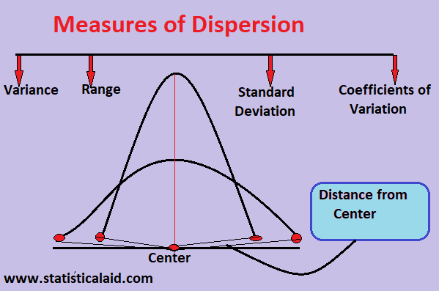
Mathematical and Statistical Methods for Data Analysis
Dispersion Analysis:
General Overview
This diagnostic method is used to determine how dispersed or stretched your data set is. Measuring dispersion establishes the variation between items, which can help determine the reliability and relevance of your data.
How Does It Work?
The first step in performing dispersion analysis is to measure the variation among the data points themselves. Next, take the value of that variation and compare it to the standard deviation of the entire dataset. If the difference between the value of the variation and the average deviation is high (i.e., if your data is stretched), then the dispersion is high.
Example
Investors often use dispersion analysis to assess the risk of an investment. By looking at the dispersion of returns on a certain investment, investors can gauge its risk. Say you’re looking at a stock that has high dispersion. In other words, its range of possible outcomes (returns) is far apart.
Source: statisticalaid.com

Slide 20
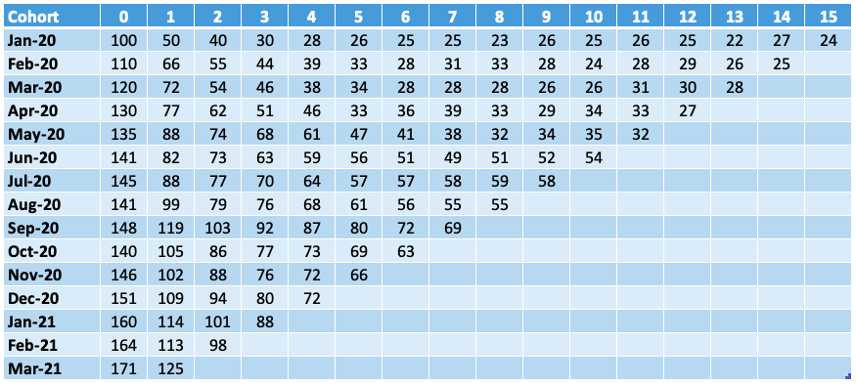
Mathematical and Statistical Methods for Data Analysis
Cohort Analysis:
General Overview
Cohort analysis evaluates the data gathered from groups of subjects who share one or more common characteristics during a specific time period. These groups are referred to as cohorts.
How Does It Work?
Cohort analysis works by first establishing your group or cohort, then tracking the behavior of that cohort over time to look for patterns of behavior and gain insight into future behavior.
Example
An example of cohort analysis would be if your company offered a $100 instant rebate to customers who buy a specific product through your online store. Customers who purchase the product and claim their instant rebate are your cohort. For the next 12 months, you track the purchasing behavior of those customers to see if any patterns arise. Do they instantly spend their rebate? Do they buy accessories related to the original product they purchased? What percentage of the cohort participates in other instant rebate promotions? Analyzing the behavior of your cohort gives you a better understanding of their shopping patterns and allows you to predict what their future behavior might be.
Source: mobilespoon.net

Slide 21
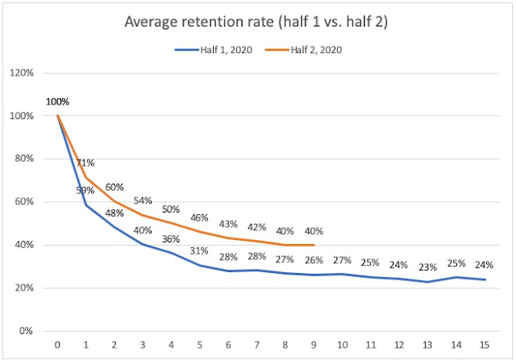
Mathematical and Statistical Methods for Data Analysis
Cohort Analysis:

Slide 22

Mathematical and Statistical Methods for Data Analysis
Cluster Analysis (Subjective Segmentation)
General Overview
Cluster analysis is used to identify the different structures in your data set.
How Does It Work?
Using this technique, analysts collect similar data points from a given set of data and put those points into a group, or cluster. Analysts can then look for patterns within those clusters in order to glean insights and predict future behaviors.
Example
In marketing, cluster analysis is used to sort a large and eclectic customer base into smaller groups of shoppers with similar demographics. This is how we get targeted
advertising.

Slide 23
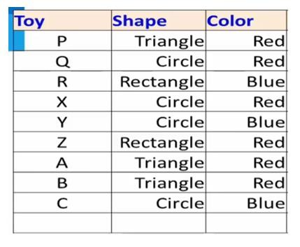
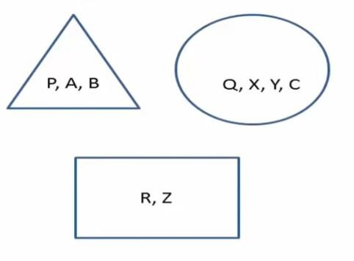
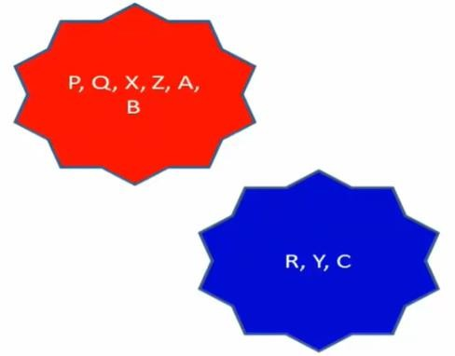
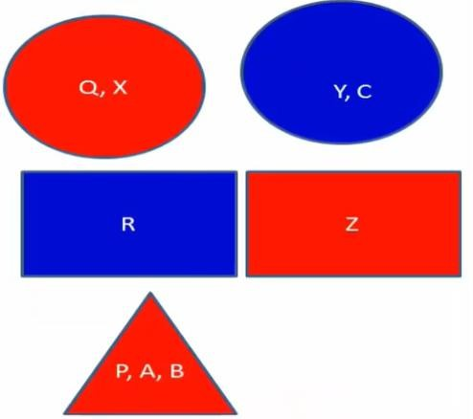
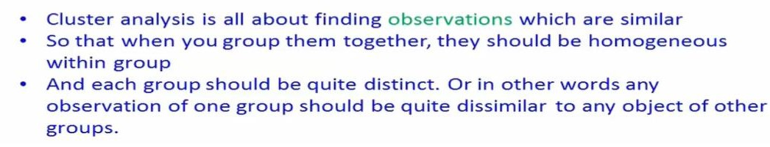
Cluster Analysis (Subjective Segmentation)
Mathematical and Statistical Methods for Data Analysis
Shape
Color
Shape & Color
Can you make three group considering shape and color?
Yes, but for that we need special algorithm and tools

Slide 24
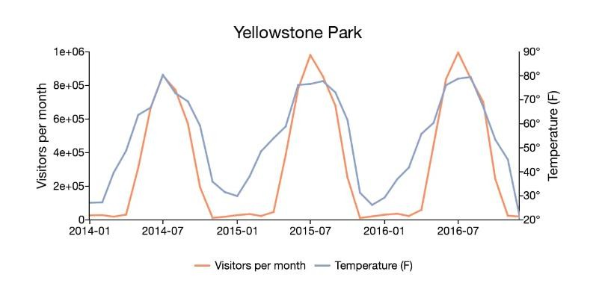
Mathematical and Statistical Methods for Data Analysis
Time Series Analysis:
General Overview
Time series analysis is a method of statistical analysis
used to forecast patterns over time.
How Does It Work?
By measuring the same, specific variable at different points in time, data analysts can pick out trends and patterns that allow them to make informed predictions about future events.
Example
A simple example of time series analysis is if you noticed a surge in stocking cap sales during the month of November every year. Using time series analysis, you could predict that this November stocking cap sales would be high.
Source: APTECH

Slide 25
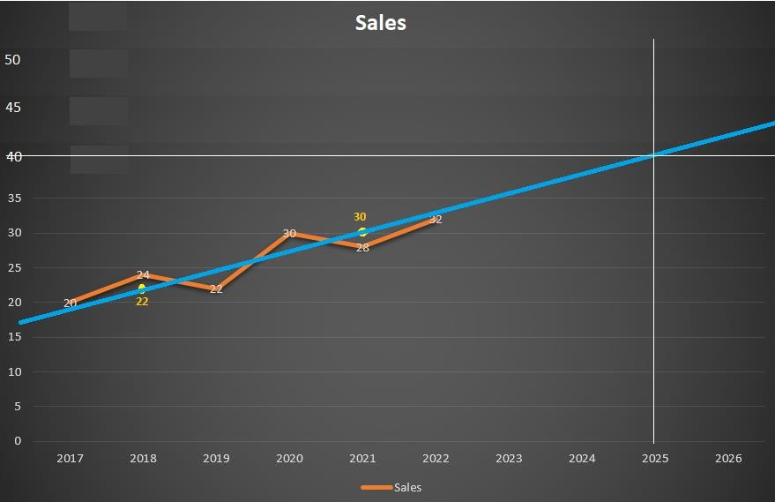
Time Series Analysis:
Mathematical and Statistical Methods for Data Analysis
Year | 2017 | 2018 | 2019 | 2020 | 2021 | 2022
Sales | 20 | 24 | 22 | 30 | 28 | 32
What would be the sales of 2025?
Solution:
Semi Average Method
Table for calculation of semi average
Year | Sales | Total | Average
2017 | 20
2018 | 24 | 20+24+22 = 66 | 22
2019 | 22
2020 | 30
2021 | 28 | 30+28+32 = 90 | 30
2022 | 32

Slide 26
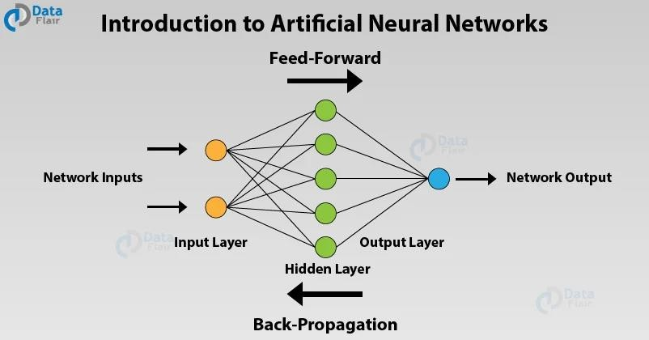
Methods Based on The Artificial Intelligence, Machine Learning and Heuristic Algorithms
Artificial Neural Network Analysis:
General Overview
Artificial neural network analysis uses machine learning to analyze data and make inferences similar to how a human brain might. As more data is introduced, the better neural networks become at recognizing patterns and discovering trends.
Related Read: These Machine Learning Startups Are Ushering in a Data Revolution
How Does It Work?
Artificial neural network analysis works by introducing data into the network in order to train it how to make predictions—it’s similar to how the human brain works. These predictions are tested for accuracy and then refined. As more data is introduced, the network continues to “learn” and update its predictions.
Example
Neural networks are frequently used in the finance sector to forecast market outcomes over time, analyze transactions, assess risk, and more.

Slide 27
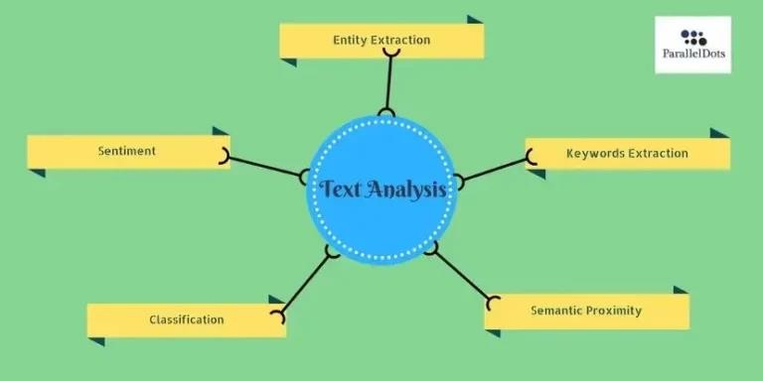
Methods Based on The Artificial Intelligence,
Machine Learning and Heuristic Algorithms
Text analysis :
General Overview
Text analysis, or sentiment analysis, is a qualitative data analysis method that searches for trends and patterns in textual data to better understand how customers feel.
How Does It Work?
Text analysis uses an array of algorithms trained to associate certain words with certain thoughts, feelings, or opinions. This information is used to deduce how customers feel about a particular thing.
Example
For example, if someone inputted the textual data “boring” to describe a newly released film, that data would be tagged as expressing a negative sentiment.

Slide 28
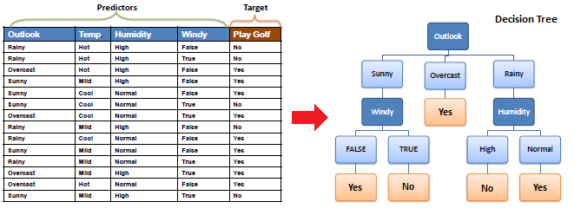
Methods Based on The Artificial Intelligence, Machine Learning and Heuristic Algorithms
Decision Trees Analysis:
General Overview
This is another very popular and modern classification algorithm in data mining and machine learning. The decision tree is a tree-shaped diagram that represents a classification or regression model.
How Does It Work?
It divides a data set into smaller and smaller sub- datasets (that contain instances with similar values) while at the same time a related decision tree is continuously developed. The tree is built to show how and why one choice might lead to the next, with the help of the branches.
Source: saedsayad

Slide 29











Library & tools

Slide 30
Thank You

